Slide 1
Cloud Computing

Slide 2
What is Cloud Computing?
Distributed computing on internet or delivery of computing service over the internet.
E.g. Yahoo!, Gmail, Hotmail.
Instead of running an e-mail program on your computer, you log in to a Web e-mail account remotely.
E.g. E-mail is sent to client after it touches the sensor.

Slide 3
History
Concept evolved in 1950(IBM) called RJE(Remote Job Entry Process).
In 2006 Amazon provided first public cloud AWS(Amazon Web Service)

Slide 4
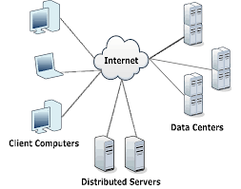
Cloud Components
It has three components
Client Computers
Distributed Servers
Datacenters

Slide 5
Clients
Clients are the devices that the end user interact with cloud.
Three types of clients:
Mobile
Thick
Thin (Most Popular)

Slide 6

Datacenter
It is collection of servers where application is placed and is accessed via internet.

Slide 7
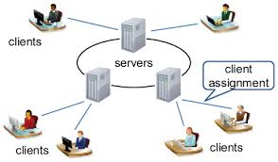
Distributed Servers
Often servers are in geographically different places, but server acts as if they are working next to each other.

Slide 8
Central Server
It administers the system such as monitoring traffic, client demands to ensure everything runs smoothly.
It uses a special type of software called Middleware.
Middleware allow computer to communicate each other.

Slide 9
Service Models
There are three types of service models-
IaaS (Infrastructure as a Service): Just network is provided.
PaaS (Platform as a Service): Operating system and network is provided
SaaS (Software as a Service): Required software, operating system and network is provided.

Slide 10
Deployment of Cloud Service
Public Cloud
Private Cloud
Community Cloud
Hybrid Cloud (Combined Cloud)

Slide 11
Why cloud service is popular?
Reduce the complexity of networks.
Do not have to buy software licenses.
Customization.
Cloud providers that have specialized in a particular area (such as e-mail) can bring advanced services that a single company might not be able to afford or develop.
Scalability, reliability and efficiency.
Information at cloud are not easily lost.

Slide 12
Application
Social Networking sites.
E-mail sites.
Search Engines.
Many more services over the internet.

Slide 13
Thank You

